Slide 1
One hidden layer
Neural Network
Gradient descent for
neural networks

Slide 2
Video Purpose
How to implement gradient descent for neural network with one hidden layer.
Equations required for back prop for gradient descent.
In next video, we will see why these equations are correct equations.

Slide 3
Parameters: Read it
The Nx will be indexed as well for each layer, in the first layer we term it as n raised 0 & than the hidden layer nodes will become the features for the output layer. & n raised 2 will become features for the output layer.
So we have weight matrices & bias values as other params.
For the first layer weight matrix, its dimensions are N1 by N0 where N raised 1 is the number of nodes in the first hidden layer & N 0 is the actual input i.e. our x values.
Similarly, bias is a column vector with dimensions equal to number of nodes in next layer by 1.
So lets summarize the understanding of weight matrix dimension. If the weight matrix that we are talking about is of for connecting layer a with layer b. than its daimonions will be layer b nodes by layer a nodes.
Parameters in case of NN should be initialized randomly.

Slide 4
Cost Function
For now we assume that the loss function same as of logistic regression.
In case of binary classification, same loss function can be used.

Slide 5
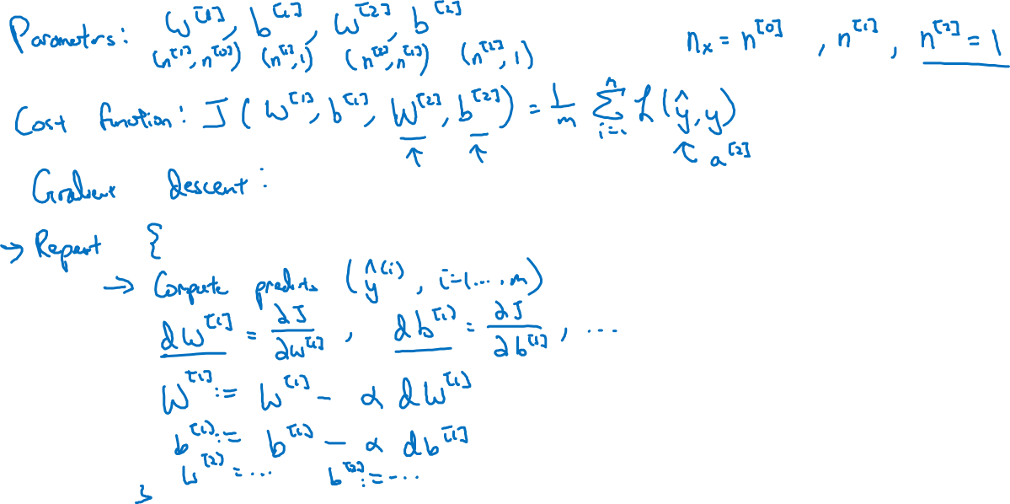
Gradient descent for neural networks
Notes:
Repeat process is same for each example, where we compute predicted values, cost, & derivatives for W & b.
The key is to how to compute these Dw1 , Db1 partial derivatives. Professor just gave us the equations to compute these values & in later videos he will explain further.

Slide 6
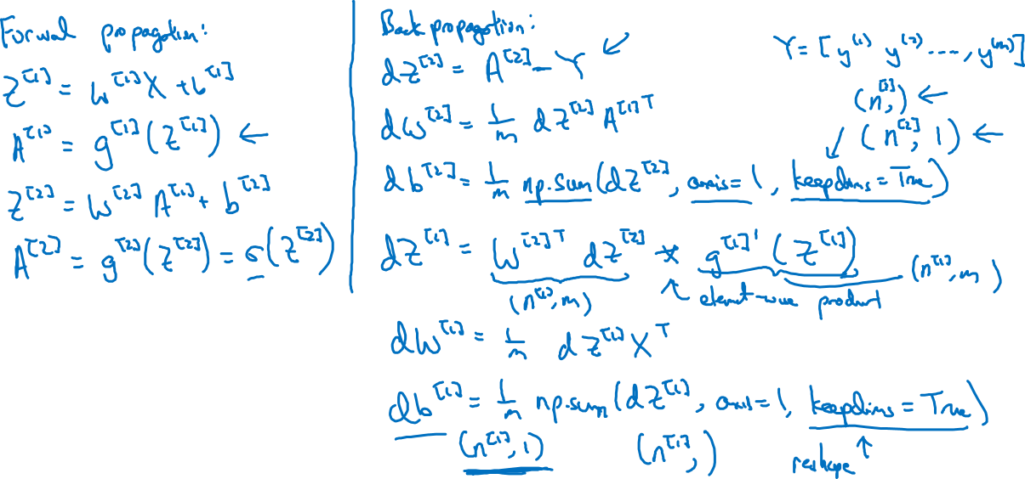
Formulas for computing derivatives
Notes:
In case of last activation , in case of binary classification the activation function should be sigmoid.
Backward propagation derivation part:
First we calculate the derivative dz which is derivative of cost function wrt to z for the output layer.
Using that we can compute the derivatives of cost function wrt to weights
Keepdims = true makes sure python putput vector,matrix instead of funny one rank arrays.
After computing the terms for outer layer, we also compute them for hidden layer. In this case the formula for dz depends upon the activation function we used.
Make note that in case of Dz1 we are doing element wise multiplication between the 2 matrices.
Keep dims is important.

Slide 7
4 equations for forward
6 equations for backward propagation.
Watch the next video.

